Slide 1

ENGG 404 2020W:
Risk Management and Professionalism at PCL Construction
Roger Keglowitsch
COO, Heavy Industrial

Slide 2
Learning Objectives
To assess how PCL ensures an outstanding safety culture
To differentiate between the challenges of technical requirements and human behaviours/communications in terms of safety
To examine why some workers ignore safety rules/procedures
To explain how PCL ensures sub-contractor safety excellence

Slide 3
Road map
Safety Culture
Safety Rules
Challenges in the field
Sub-contractors!
Summary
Q&A

Slide 4
What is the most influential action an engineer can do when walking a jobsite?
Wear the required personal protective equipment
Wear the required fall protection equipment
Intervene in unsafe acts and behaviours
Don’t disturb people while they’re working
Provide positive feedback when you see safe behaviours
All of these things are robust risk management behaviours, but the most important action you can take is to intervene in unsafe acts and behaviours

Slide 5
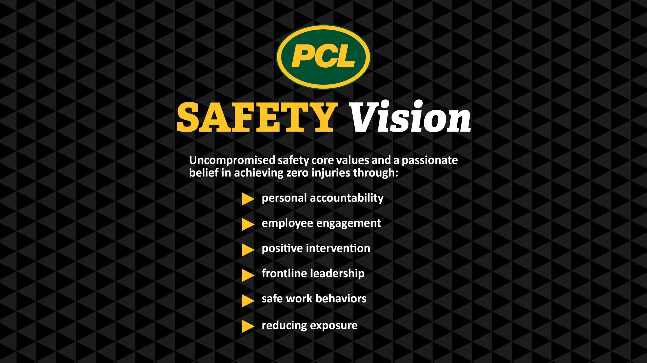
How do you get workers to live and breathe the safety culture of the organization?

Slide 6
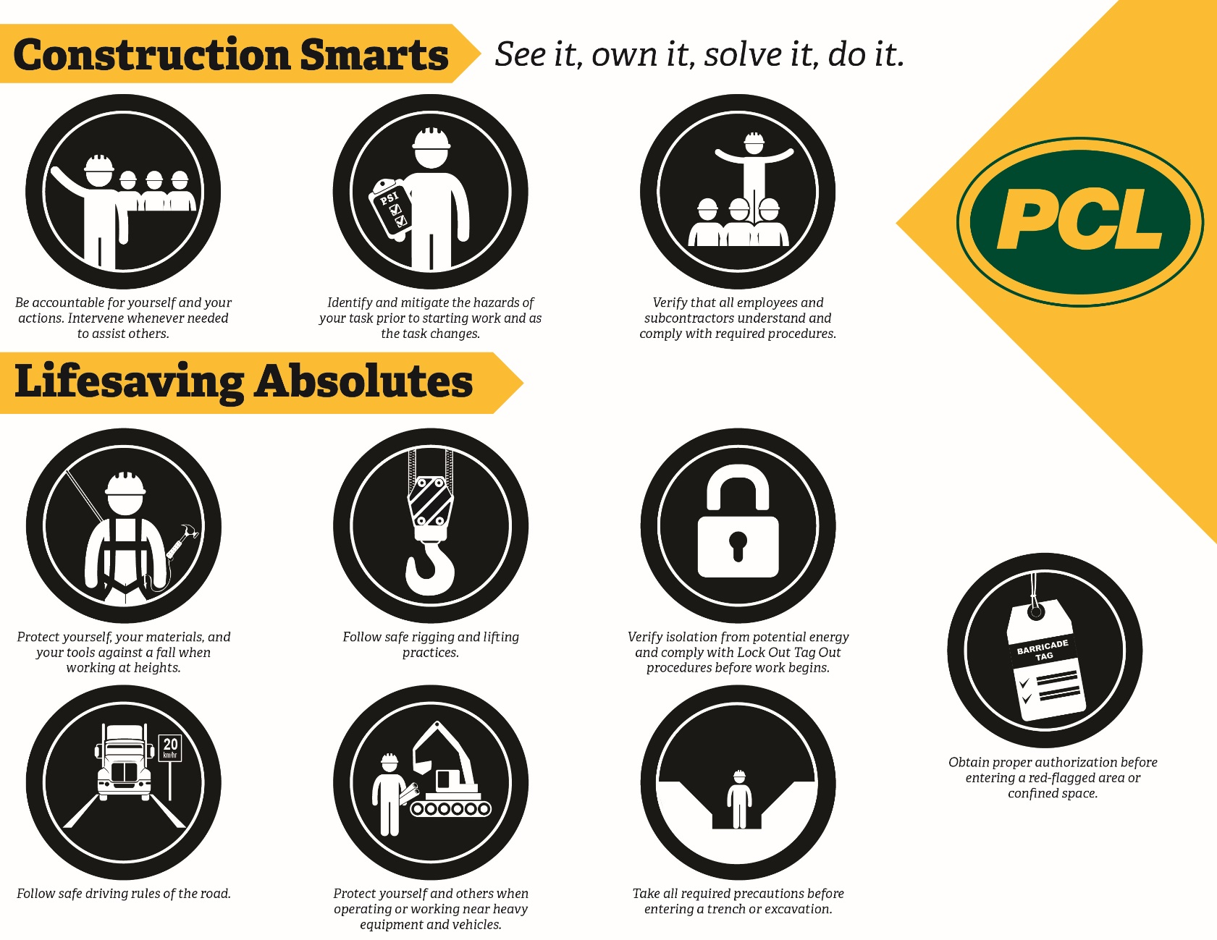
How do you get workers to live and breathe the safety culture of the organization?
Notes:
ZERO INCIDENTS: A SHARED GOAL
With an average of more than 20 million work hours annually, the PCL family of companies maintain an overall total recordable incident rate (TRIR) and overall lost-time frequency rate (LTFR) among the lowest in the industry.
PCL is committed to providing employees with equipment, training, and best practices to achieve a shared goal of zero incidents.
PCL strives to have employees leave work and return to their families safely every day.

Slide 7

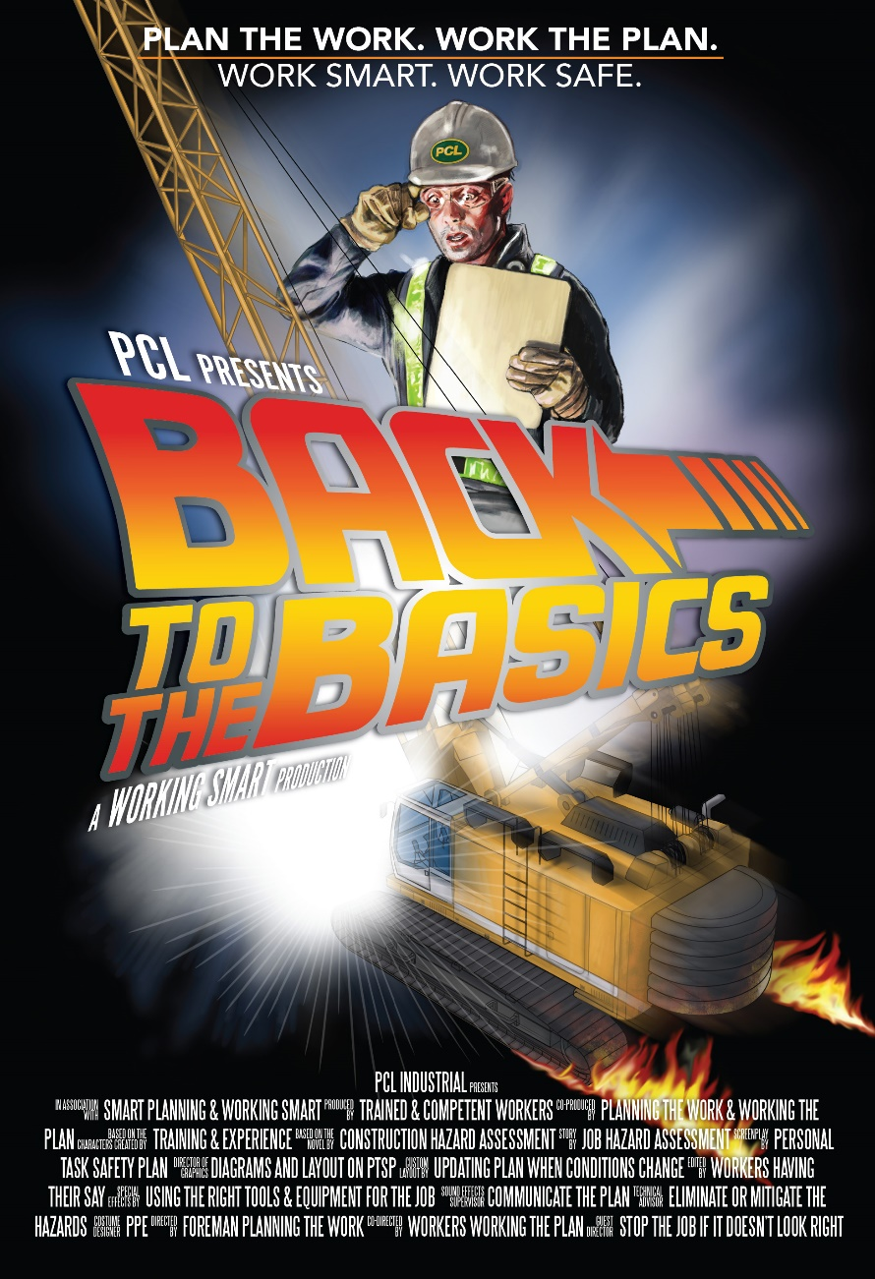
How do you get workers to live and breathe the safety culture of the organization?

Slide 8
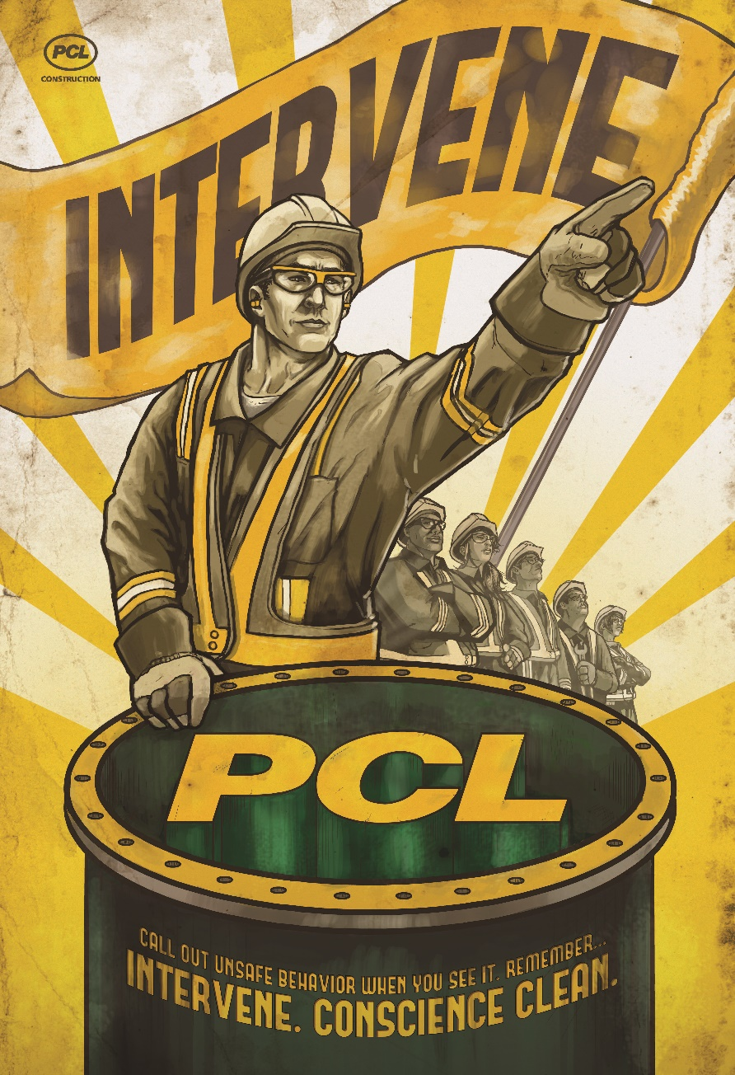
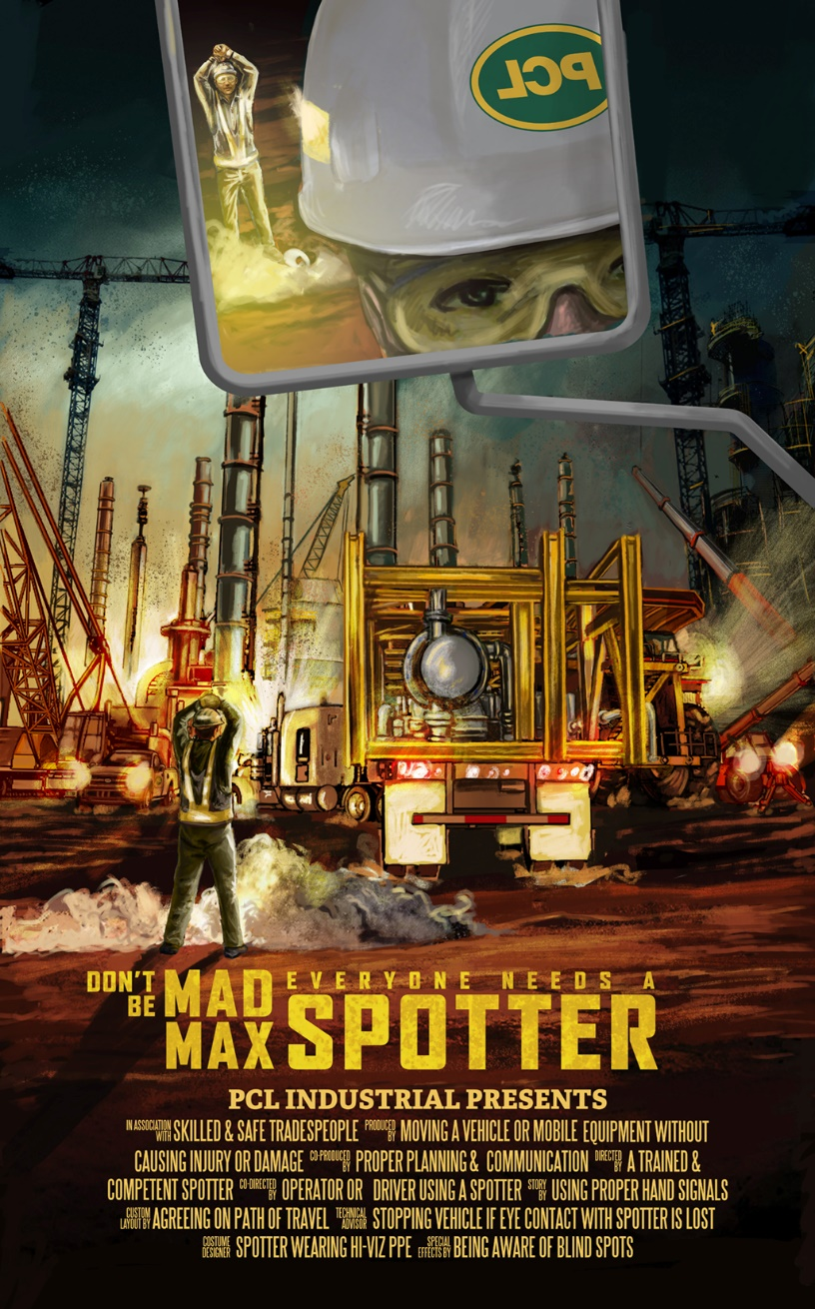
How do you get workers to live and breathe the safety culture of the organization?

Slide 9
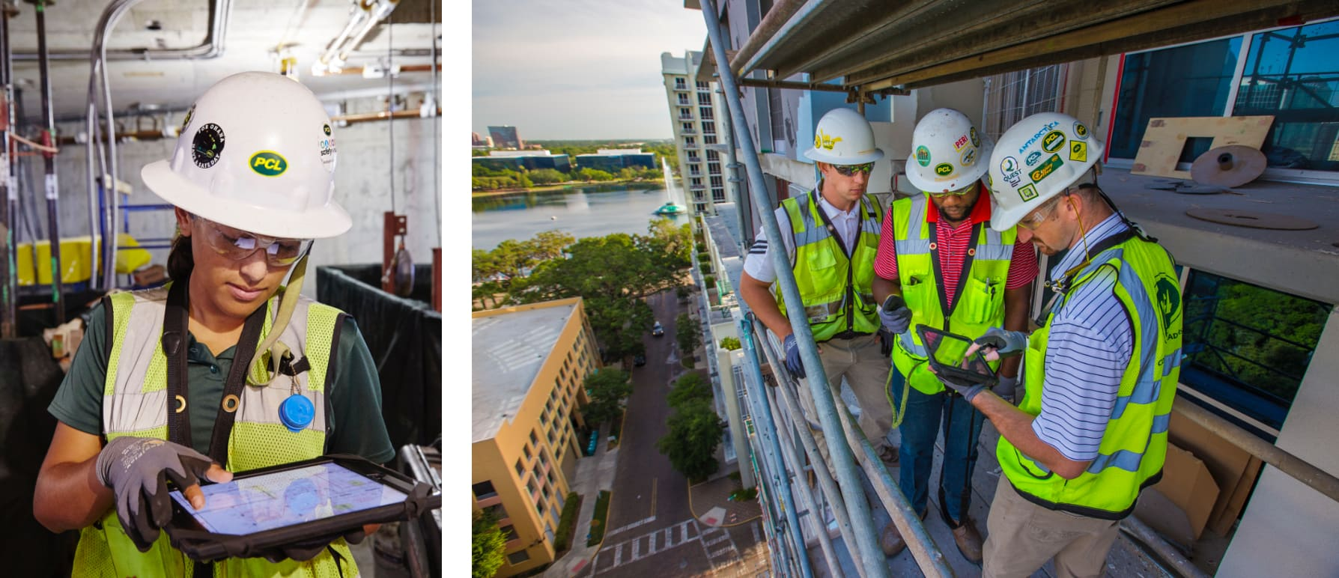
What are some challenges you will face in the field?
Learning begins when you hit the project site!
Technical requirements VS Human behaviours/communications
Be a solution provider!

Slide 10

Why do people choose to ignore safety rules/procedures?
They have not been explained well enough
The WHY has not been explained
Not enforcing rules….
Complacency
Risk tolerance
Rules can be too complicated

Slide 11
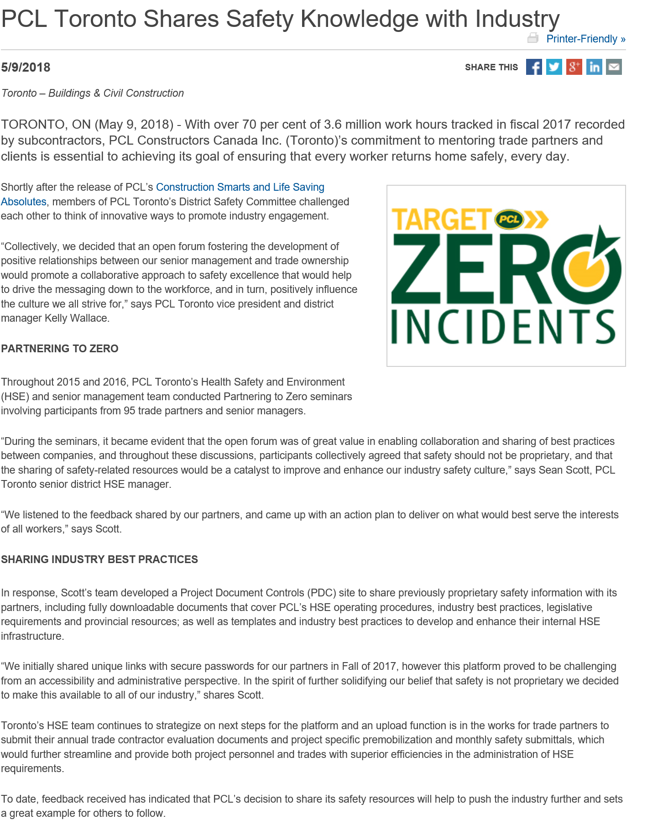
How does PCL ensure its contractors work safely on PCL work sites?
One of our biggest challenges!
Subcontractors are vetted
One Team Approach
Senior Executive Commitment

Slide 12
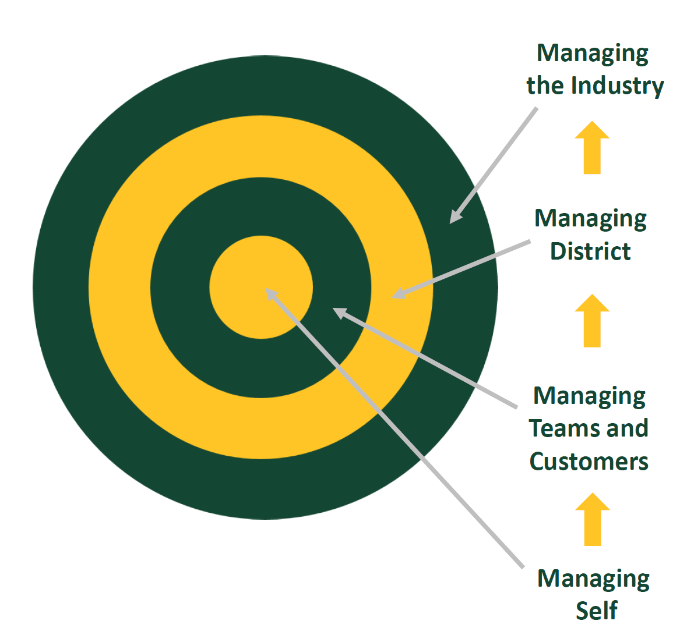
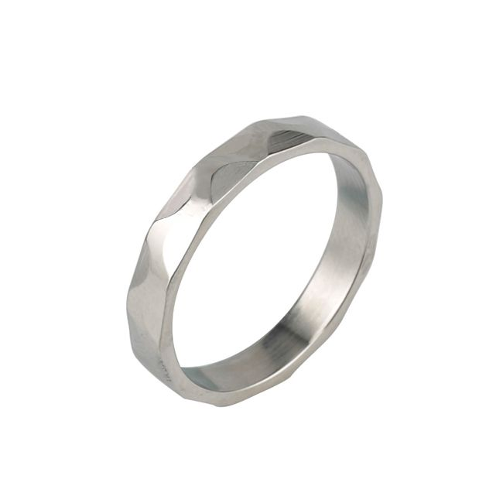
Final Thoughts

Slide 13
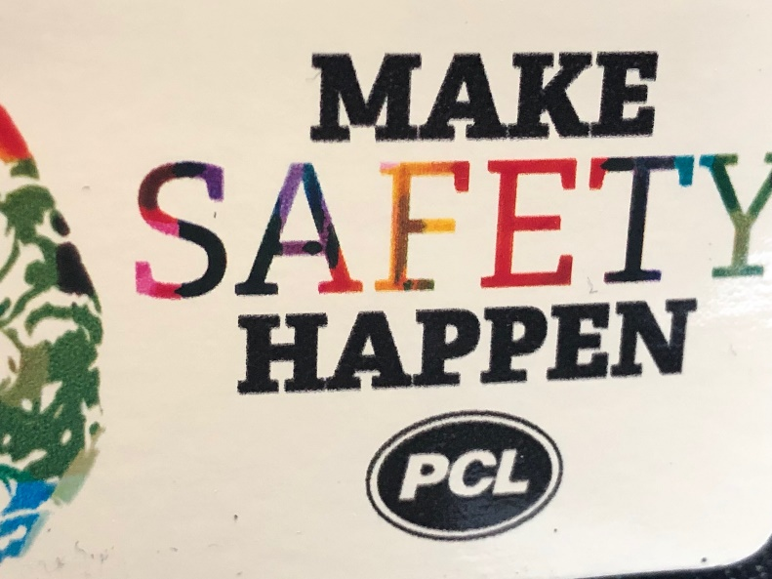
Questions?

